Slide 1
Executive Compensation Review
Introduction
Automation Process using R
KPIs and Analysis Points
Companies for Analysis
Analysis of Costco

Slide 2
Introduction (What is DEF 14A Form)
What is SEC :
The Securities and Exchange Commission (SEC) is government commission made by congress to manage the securities advertises and ensure financial specialists. Notwithstanding regulation and insurance, it additionally screens the corporate takeovers in the U.S.
What is def 14a form?
Form DEF 14A, which is otherwise called "definitive proxy statement", is required under Section 14(a) of the Securities Exchange Act of 1934. This structure is documented with the SEC when an authoritative intermediary proclamation is given to shareholders and helps the SEC guarantee that shareholders' rights are maintained.

Slide 3
Executive Compensation Table
What is exec compensation?
Executive Compensation is an expansive term for the money related remuneration honored to a company's executives
Fields of exec compensation:
Field Name | Comments
Salary | Salary paid to the CEO for the fiscal year
Bonus | Bonus paid to the CEO in the fiscal year
Value of Stock Awards | The estimation of the stock honors conceded in a financial year as recorded in the Summary Compensation Table. Stock grants are as stock or confined stock that is either time vesting or performance vesting
Value of Option Awards | Stock Options are the privilege to buy a predetermined number of normal stock at an expressed activity cost for a predefined timeframe
Non-Equity Incentive Plan Compensation | This is remuneration earned compliant with non-equity incentive plans. This incorporates incentive plan awards that are not stock or value. Incentive plans for the most part accommodate pay planned to serve as an impetus for execution to happen over a predefined period
All Other Compensation | The value of perquisites and other benefits provided to the CEO. This could include personal use of company cars and airplanes, country club memberships, tax reimbursements, insurance plans or payments to saving plans. Payments to savings plans are part of Change in Pension Value and Non-Qualified Deferred Compensation Earnings
Total Compensation | Addition of all the above fields

Slide 4
Points to be considered for analysis
KPIs to be considered for analysis:
Salary of the CEO
Options Awards
Vested Stock Awards
Bonus obtained
Analysis & Comparison:
Trends in Salary of CEOs over the period of ten years
Trends in Options Awards over the period of ten years
Trends in Vested Stock Awards over the period of ten years
Compassion between the KPI for companies from different domains

Slide 5
Companies Considered for Analysis
Sr. No | Company Name | Sector/Domain | Data Duration
1 | Costco Wholesale | Retail | 1992 - 2015

Slide 6
Automation Using R
Steps for Automation:

Slide 7

Analysis of Costco Wholesale

Slide 8
Costco Wholesale Information
Price/Costco INC is an American membership-only warehouse club that provides a wide selection of merchandise
The DEF 14A filings includes the executive compensation tables from 1992 to 2015.
CEOs for this company are James D. Sinegal (1992 ~ 2011) and W. Craig Jelinek (2012 ~ now)
The range of their salary is from $300,000.00 (1992, 1993, 1994, CEO: James D. Sinegal) to $699,810.00 (2015, CEO: W. Craig Jelinek)
The range of the Vested Stock Awards is from $0 to $5,322,962.00 (2015, CEO: W. Craig Jelinek). In Costco, the Stock Awards received by the CEO started from 2007
The range of Option Awards is from $0 to $1,615,544.00 (2007, CEO: James D. Sinegal). Option Award is not available since 2010

Slide 9
Costco (Executive Compensation Table)
Name and Principal Position | Year | Salary($) | Bonus($) | Total Salary With Bonus | Other Annual Compensation($) | Stock Award ($) | Option Awards($) | Non-Equity Incentive Plan Compensation ($) | All Other Compensation ($) | Total Compensation($)
W. Craig Jelinek President and Chief Executive Officer | 2015 | $699,810.00 | $188,800.00 | $888,610.00 |  | $5,322,962.00 | $0.00 | $35,319.00 | $95,233.00 | $6,342,124.00
 | 2014 | $650,000.00 | $90,400.00 | $740,400.00 |  | $4,783,200.00 | $0.00 | $8,541.00 | $90,786.00 | $5,622,927.00
 | 2013 | $650,000.00 | $88,800.00 | $738,800.00 |  | $4,527,994.00 | $0.00 | $29,033.00 | $89,648.00 | $5,385,475.00
 | 2012 | $662,500.00 | $168,233.00 | $830,733.00 |  | $3,870,300.00 | $0.00 | $21,226.00 | $88,514.00 | $4,810,773.00
James D. Sinegal Chief Executive Officer President and Chief Executive Officer | 2011 | $350,000.00 | $198,400.00 | $548,400.00 |  | $1,560,015.00 | $0.00 | $1,538.00 | $81,206.00 | $2,191,159.00
 | 2010 | $350,000.00 | $190,400.00 | $540,400.00 |  | $2,896,030.00 | $0.00 | $0.00 | $93,004.00 | $3,529,434.00
 | 2009 | $350,000.00 | $75,000.00 | $425,000.00 |  | $1,952,867.00 | $893,941.00 | $2,736.00 | $78,576.00 | $3,353,120.00
 | 2008 | $350,000.00 | $80,000.00 | $430,000.00 |  | $3,034,471.00 | $1,340,121.00 | $34,974.00 | $73,442.00 | $4,913,008.00
 | 2007 | $350,000.00 | $80,000.00 | $430,000.00 |  | $803,739.00 | $1,615,544.00 | $63,422.00 | $73,652.00 | $2,986,357.00
 | 2006 | $350,000.00 | $0.00 | $350,000.00 | $42,941.00 | $0.00 | $0.00 | $0.00 | $61,688.00 | $454,629.00

Slide 10
Costco (CEO Salary Trend Analysis)
Name of the CEO | Year | Salary($) | % Change in Salary
James D. Sinegal | 2006 | $350,000.00
 | 2007 | $350,000.00 | 0.00%
 | 2008 | $350,000.00 | 0.00%
 | 2009 | $350,000.00 | 0.00%
 | 2010 | $350,000.00 | 0.00%
 | 2011 | $350,000.00 | 0.00%
W. Craig Jelinek | 2012 | $662,500.00 | 89.29%
 | 2013 | $650,000.00 | -1.89%
 | 2014 | $650,000.00 | 0.00%
 | 2015 | $699,810.00 | 7.66%

Slide 11
Costco (CEO Salary Trend Analysis)
Salary Trend:
For analysis propose we consider data for the past 10 years
To show a trend in the increase in salary of the CEO we use %change in salary to get a better idea of how the salary has increased over the 10 years

Slide 12
Costco (CEO Salary + Bonus Trend Analysis)
Name and Principal Position | Year | Total Salary With Bonus | % Change in Salary + Bonus
James D. Sinegal | 2006 | $350,000.00
 | 2007 | $430,000.00 | 22.86%
 | 2008 | $430,000.00 | 0.00%
 | 2009 | $425,000.00 | -1.16%
 | 2010 | $540,400.00 | 27.15%
 | 2011 | $548,400.00 | 1.48%
W. Craig Jelinek | 2012 | $830,733.00 | 51.48%
 | 2013 | $738,800.00 | -11.07%
 | 2014 | $740,400.00 | 0.22%
 | 2015 | $888,610.00 | 20.02%

Slide 13
Costco (CEO Salary + Bonus Trend Analysis)
Salary with Bonus Trend:
Every year the CEO of a company is entitled to a bonus amount on the salary depending on his performance
To better understand the performance of the CEO throughout the years we can plot a graph for the total cumulative salary which is salary plus the bonus amount

Slide 14
Costco (CEO Stock Awards Analysis)
Name and Principal Position | Year | Stock Award ($) | % Change in Stock Award
James D. Sinegal | 2007 | $803,739.00
 | 2008 | $3,034,471.00 | 277.54%
 | 2009 | $1,952,867.00 | -35.64%
 | 2010 | $2,896,030.00 | 48.30%
 | 2011 | $1,560,015.00 | -46.13%
W. Craig Jelinek | 2012 | $3,870,300.00 | 148.09%
 | 2013 | $4,527,994.00 | 16.99%
 | 2014 | $4,783,200.00 | 5.64%
 | 2015 | $5,322,962.00 | 11.28%

Slide 15
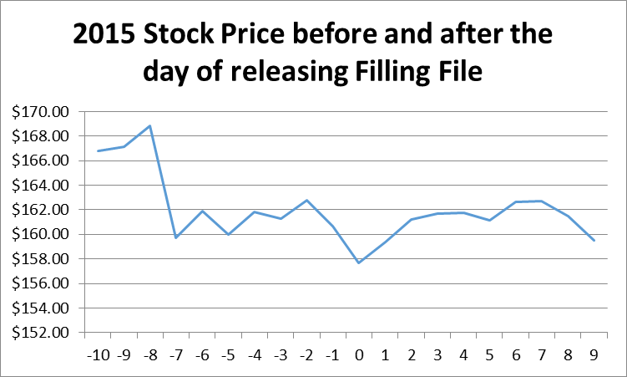
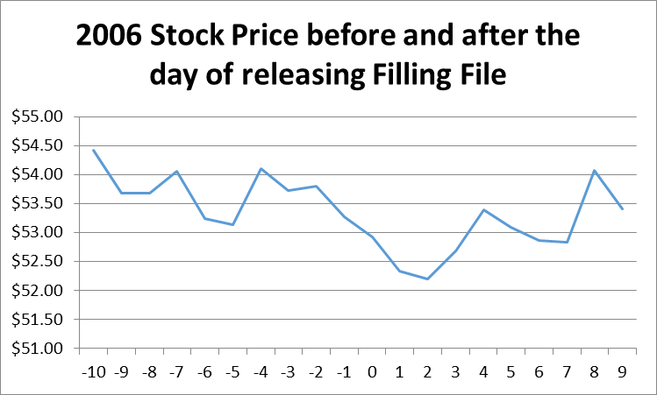
Costco (Stock Price Analysis)
Stock Price Trend:
Stock Price is affected by the company’s performance.
Bonus in 2015 is $188,800.00
Bonus in 2015 is $0.

